Slide 1

Ministry of European Funds
Evaluation use and utility in Romania.
Evaluation follow-up in case of NEETs intervention
13 September 2018

Slide 2


Evaluation Use, Utility, Usability
Usually, the discussions on 3 U does not go beyond a description of the way in which the output from an evaluation might be disseminated.
Use of evaluations refers to the practices associated with the way in which the outputs of an evaluation is used in an organizational setting or policy context as a resource for onward practice, policy or decision making.
An evaluation has utility if it is presented in a way that makes it useful, and an evaluation is used if there are immediate and direct applications of the evaluation findings.
Usability of evaluation - the extent to which the design of an evaluation − both its output and the way it is undertaken − maximizes, facilitates or disables its potential use.
Notes:
Weiss (1979) did not like the term utilization because she felt it sounded too concrete, and the practice of using evaluation findings is more fluid than that.
Stevenson (1980) felt that too much credence was being given to utility and utilization is the more appropriate term. He thought utility only looked at the evaluator’s work while utilization was more suitable because it also focused on unintended evaluation consequences and multiple evaluation finding uses.
Alkin (1982) said that an evaluation has utility if it is presented in a way that makes it useful, and an evaluation is utilized if there are immediate and direct applications of the evaluation findings.
King and Pechman (1982) felt utilization was a term that could be easily misunderstood, while use is a term with few inappropriate connotations.

Slide 3
Structures and roles for the 3 U in Romania
Terms of reference
Evaluation methodology
Evaluation report
Follow-up report
Evaluation Plan
Evaluation Steering Committee
Evaluation Unit
Sectoral/thematic stakeholders,
including social partners
Scientific Committee
Evaluator
Academia

Slide 4
Key elements of the 3 U in Romania
ESC composition
Interactional practices with ESC
ESC follow up
  public policy makers
  OP management bodies (MA, IB)
  Relevant data providers
  Relevant socio-economic partners
  Content of the ToR in connection to the evaluation/information needs and context
  Selection criteria for assigning evaluators
  Evaluation methodology
  Providing data and information
  Quality of the evaluation report and its readability
  Analysis of findings implications
  Deciding on an action plan
  Yearly discussions on the implementation status

Slide 5
Evaluation of NEETs interventions – a case on the 3 U
Terms of reference
Evaluation methodology
Evaluation report
Context:
Compulsory evaluation to be carried out in the end of 2015
However, very limited progress in implementation - no call lunched at that moment
Evaluation follow up
Evaluation plan
How to ensure evaluation usability, utility and use?
Discussion of the ToR within the Evaluation Steering Committee with the following main results:
  Recognition of the limited progress of the intervention questioning the evaluation utility
  Reaching a consensus on the purpose of evaluation: to inform on the measures leading to effectiveness and efficiency of the intervention
  Identifying solutions enhancing evaluability – retrospective evaluation of similar interventions on NEETs (picked up from 2007-2013 programming period)

Slide 6
Evaluation of NEETs interventions – a case on the 3 U
Terms of reference
Evaluation methodology
Evaluation report
Discussion within the ESC of the inception and evaluation report with the following main results:
Evaluation follow up
Evaluation plan
Evaluation methodology
Validation of key elements, such as programme theory etc.
In depth understanding of the evaluation process, techniques, constraints
Getting support for data provision, participation in interviews, focus groups etc.
Evaluation report
Clarification of confusing aspects
Increased readability of the report

Slide 7
Evaluation of NEETs interventions – a case on the 3 U
Terms of reference
Evaluation methodology
Evaluation report
ESC follow up with the following main results:
Evaluation follow up
Evaluation plan
Assessing implications
Confirming or reformulating recommendations to be implemented
Assigning responsibilities and timeframes
Revisiting yearly the action plan

Slide 8
Lessons learnt – NEETs interventions
How did the situation of the young NEETs evolve, including of the young NEETs of Roma ethnicity, in targeted areas (development regions, urban vs. rural areas, the Danube Delta ITI area) since the programme adoption?
fluctuating evolution over the period during 2007-2015
recorded an increase of 3.6% from 2014 until 2015, despite the negative demographic trends of the population aged between 15 and 24 years old and of the slight increase in employment rates for this category.
the increase of the young NEETs is registered in regions where their number was higher starting with 2007 (Sud-Muntenia, Centre, Southeast, regions eligible under YEI).
NEETs population in the urban areas increased in 2015 compared to 2014 as a share in the total number of NEETs compared to the NEETs population in rural areas.
The evolution of the young NEETS population of Roma ethnicity and in the Danube Delta ITI area follows the same trends as the entire category, namely an increase in 2015 compared to 2014, stronger in the urban areas.

Slide 9
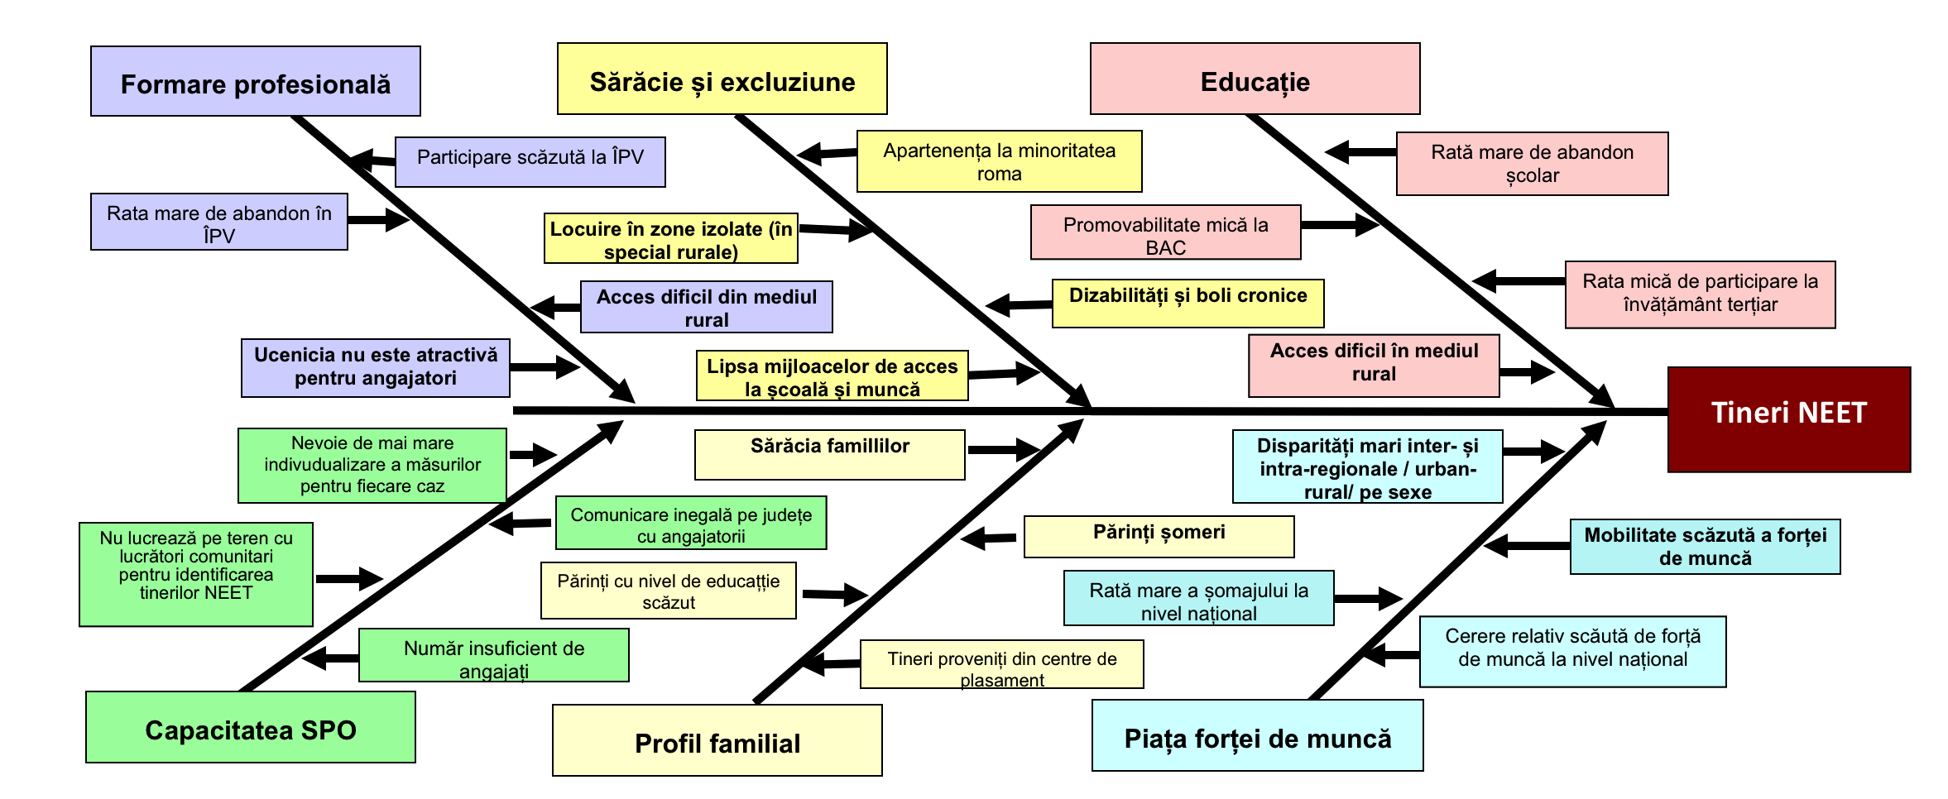
Lessons learnt – NEETs interventions
What mechanisms affect the situation of the young NEETs and how?
There are sub-categories of young NEETs who have particular needs and in their case the logic of intervention needs to be personalised.
The most important criterion which divides the young NEETs into sub-categories is the education level, followed by the area of residence (urban / rural) and their belonging to vulnerable groups.
Information, counselling and guidance and vocational training remain the most relevant interventions.
An improved intervention logic of the future projects should foresee the following additional elements: individual information, counselling and guidance on the labour market, psychological counselling, activities ensuring the support of the family members; activities which tackle functional illiteracy, accompanying for a period of time the young NEET at the apprenticeship/work place.

Slide 10
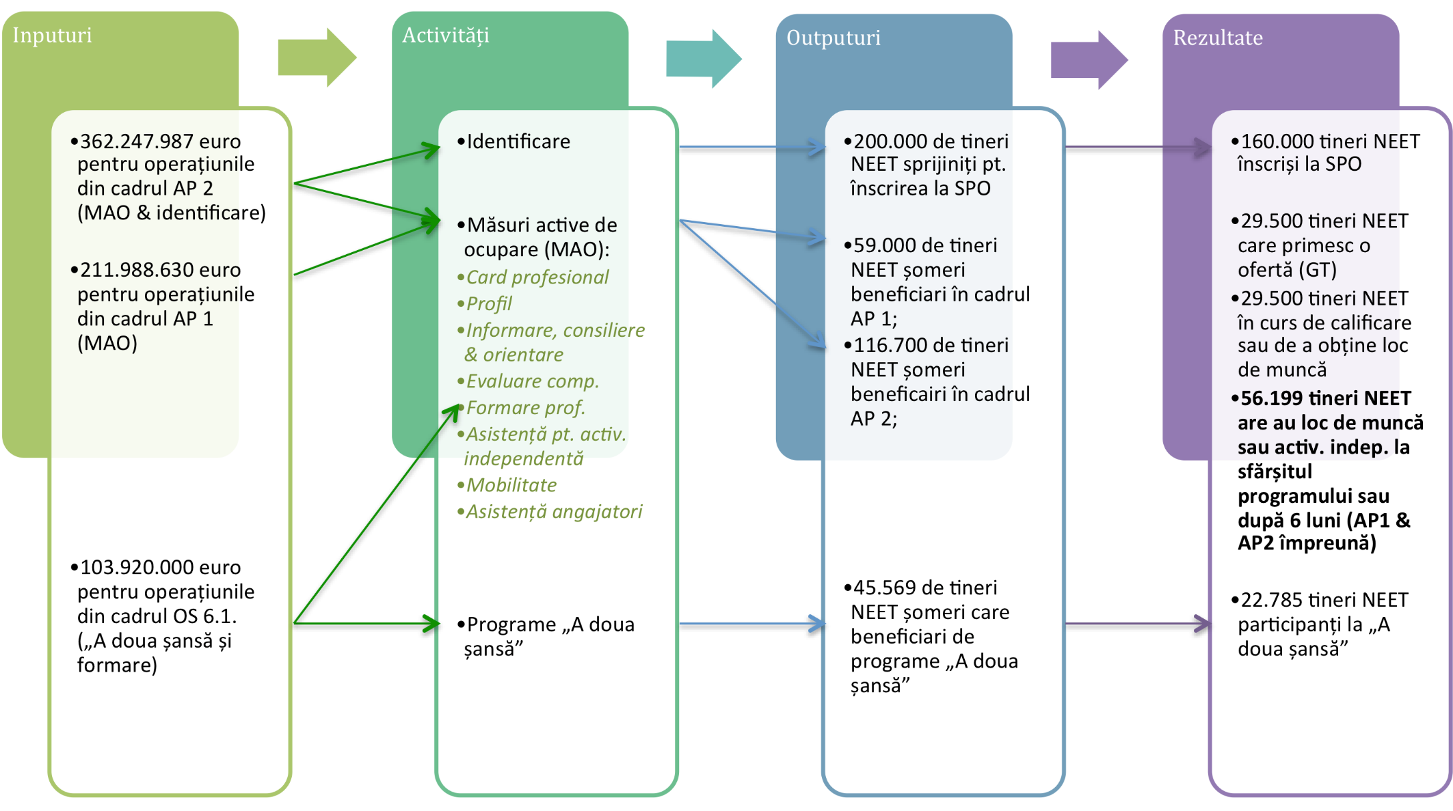
Lessons learnt – NEETs interventions
What mechanisms affect the situation of the young NEETs and how?
The most effective interventions identified by this evaluation were the following:
  (1) vocational training,
  (2) job-search and labour mediation services offered individually
  (3) information, counselling and vocational guidance.
The less effective measures:
training and support measures in the field of entrepreneurship - due to miscorrelation between the type of intervention and profiles of supported NEETs
apprenticeship – due to its duration, administrative burden and costs on the employers
initial training courses – easier to implement, but participants do not gain sufficient competencies to become employable.

Slide 11

Lessons learnt – NEETs interventions
To what extent the mechanisms are or may be improved for the programming period 2014-2020?
12 recommendations, among which:
The future projects should adequately consider the profile and individual needs of the young NEETs and the sub-categories, which should be addressed in a personalized and integrated manner (implemented)
Amend the Apprenticeship Law in order to transform this public policy tool in an efficient and effective instrument (implemented)
Operationalize as soon as possible the young NEETs database; this should contain information at individual level on the members of this target group, to be updated regularly and to be maintained (ongoing)
Ensure at operational level the coordination between the interventions planned under PA 1 (employment measures) and PA 6 of OPHC (education measures) – (theoretically put in place, to be revisited in the next evaluation to check if it works)
For entrepreneurship - ensure the selection of the most relevant representatives of this target group and to provide tutorship/mentorship programmes long enough to consolidate and maintain the legal persons newly created through projects (implemented)

Slide 12

Thank you

